Slide 1
Identity Verification using Hand Geometry
Submitted By
Amit Kumar Gautam
Notes:
‹#›

Slide 2
Objective
Development of fast and reliable identity verification system.
Development of multiprogrammed client-server architecture with raspberry PI as client node.
Minimizing bandwidth between client and server for optimum usage of network
Notes:
‹#›

Slide 3
Motivation
Current biometric security measures can be easily cracked
Researcher printed fingerprint pattern using conducting ink to unlock fingerprint locked phones.
Similarly token systems can be forged and password systems can be brute forced or remembered.
Notes:
‹#›

Slide 4
Motivation
Current security measures are costly and time consuming.
They are not very useful for real time applications
Impractical to implement as distributed system.
Notes:
‹#›

Slide 5
Motivation
Systems which use fingerprint scanners are unable to detect patterns of children and workers because extensive use of hand causes pattern deterioration.
Many children and workers dont have aadhar card yet because scanner could not get any input.
Notes:
‹#›

Slide 6
Raspberry PI
Low cost credit card sized computer which plugs into TV or monitor and can use keyboard and mouse as input.
Notes:
‹#›

Slide 7
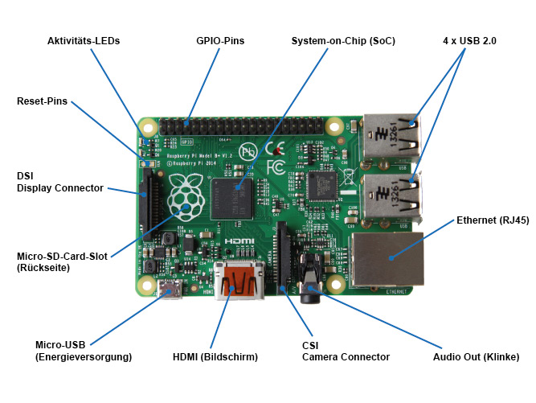
Raspberry PI
Notes:
‹#›

Slide 8
Raspberry PI
Capabilities
Browsing internet
Teaching programming to kids
Low end network nodes
Playing HD videos
Usage in IOT applications
Notes:
‹#›

Slide 9
Raspberry PI
History
Work of raspberry PI foundation, a charitable organization founded in 2009 by David Braben, Jack Lang, Pete Lomas Alan Mycroft, Robert Mullins, Eben Upton.
Supported by University of Cambridge Computer Library and tech firm Broadcom.
Notes:
‹#›

Slide 10
Methodology
Requesting PIN
A person has to enter PIN which directs database to use respective feature vector as reference for matching.
Notes:
‹#›

Slide 11
Methodology
Image Acquisition
Person will place his palm to a glass plate beneath which lies the camera which will capture the image of the hand.
Notes:
‹#›

Slide 12
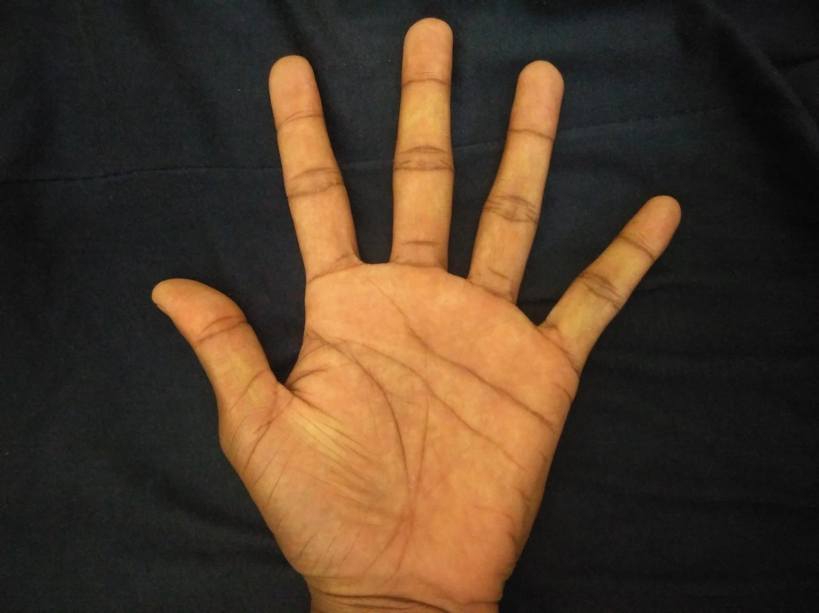
Image Acquisition
Notes:
‹#›

Slide 13
Methodology
Extraction of required region
First image will be converted into a grayscale image.
From grayscale ,we will convert it into a binary image using threshold
Threshold value we used here is 65.
Notes:
‹#›

Slide 14
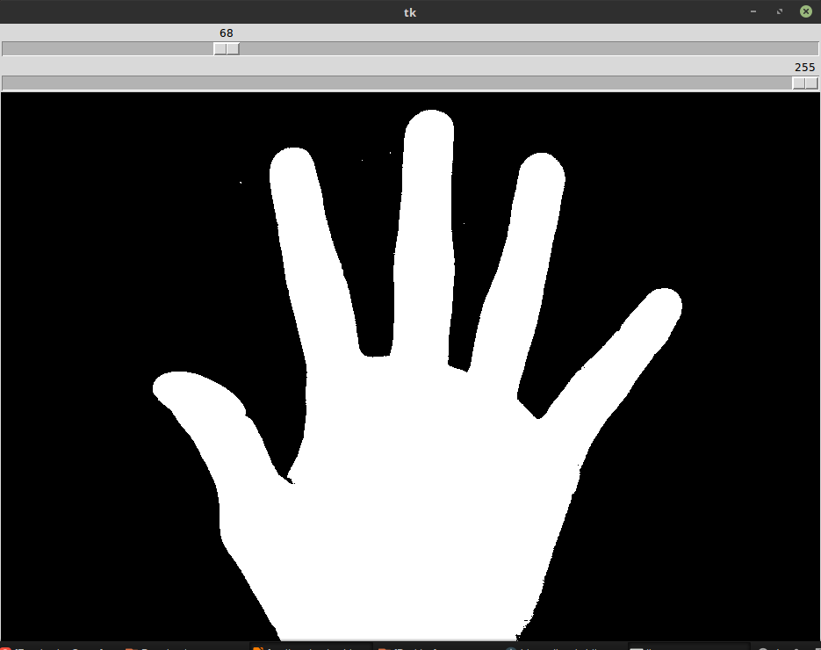
Extraction of Required Region
Notes:
‹#›

Slide 15
Methodology
Contour Extraction
After converting the image into a binary image we extracted the contour of image.
Notes:
‹#›

Slide 16
Methodology
Contour approximation
After extracting the contour of image we approximate the contour.
Approximation was done because contour on finger tips wasn’t smooth.
Notes:
‹#›

Slide 17
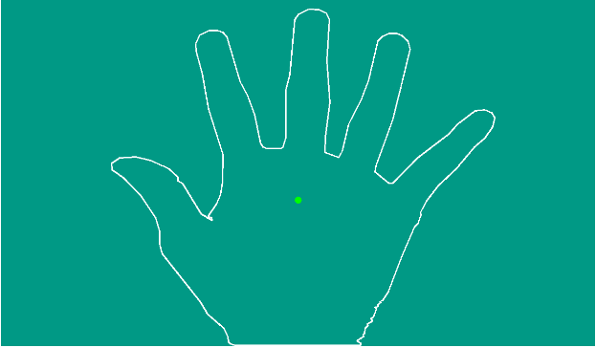

Slide 18
Methodology
Generating Moment and Centroid
We generated the moment using cv2.moment which is a inbuilt function in opencv.
From moment we also calculated the centroid of the image .
Notes:
‹#›

Slide 19
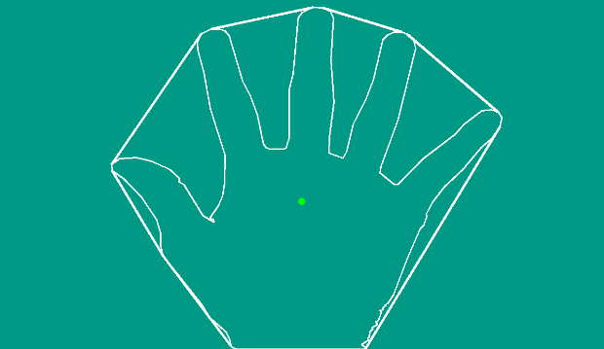

Slide 20
Methodology
Finding Valleys in Image
5 valley point were extracted using convex hull and contour .
We used convexity defect between contour and convex hull for extracting valley points.
Notes:
‹#›

Slide 21
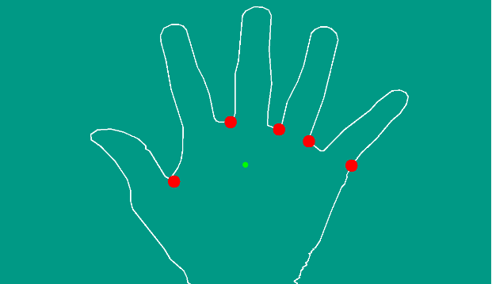

Slide 22
Methodology
Finding Tip Points in Image
We use valley points average and cenroid for the extraction of peak points.
We also used the distance between centroid and average valley point.
Notes:
‹#›

Slide 23
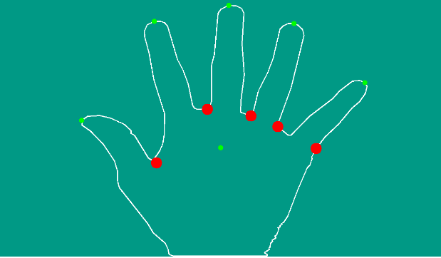

Slide 24
Methodology
Extraction of Knuckle Points
Middle points of valleys will be used as knuckle points of fingers.
For the extraction of knuckle point of thumb we used line intersection.
Notes:
‹#›

Slide 25
Methodology
Distance Between Knuckle Point and Tip Point
7 distances will be considered.
5 lengths of each finger.
Distance between thumb joint and index finger joint.
Distance between index finger joint and pinky finger joint.
Notes:
‹#›

Slide 26
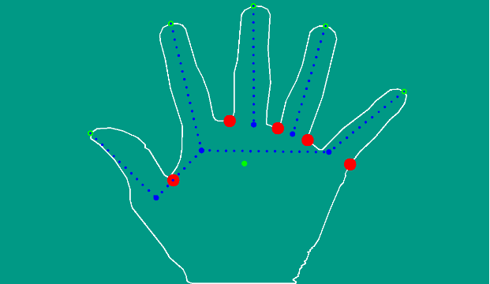
Notes:
‹#›

Slide 27
Methodology
Matching
Data will be sent to server.
Server will compare the data with reference feature if PIN is found in database.
If distance between two lies below some threshold then result is true otherwise result is false.
Server will respond to client in one of TRUE, FALSE and PIN error.
Notes:
‹#›

Slide 28
Client side
Acquire PIN and Image
Acquire contour of hand
Detect peak and valley
Calculating and sending 7 distances with PIN.
Wait for reply
Notes:
‹#›

Slide 29
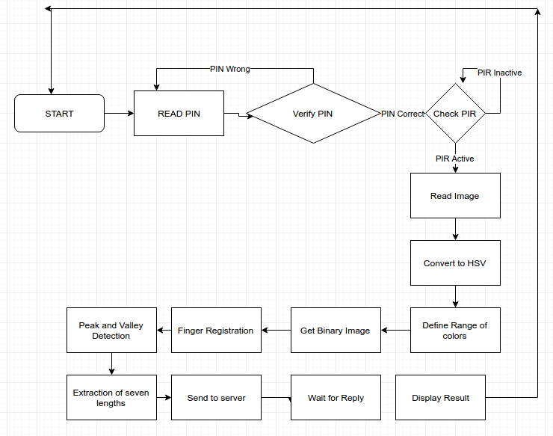
Flowchart
Notes:
‹#›

Slide 30
Example of a database
PIN | Dist 1 | Dist 2 | Dist 3 | Dist 4 | Dist 5 | Dist 6 | Dist 7
Note: PowerPoint does not allow have nice default tables – but you can cut and paste this one
Notes:
‹#›

Slide 31
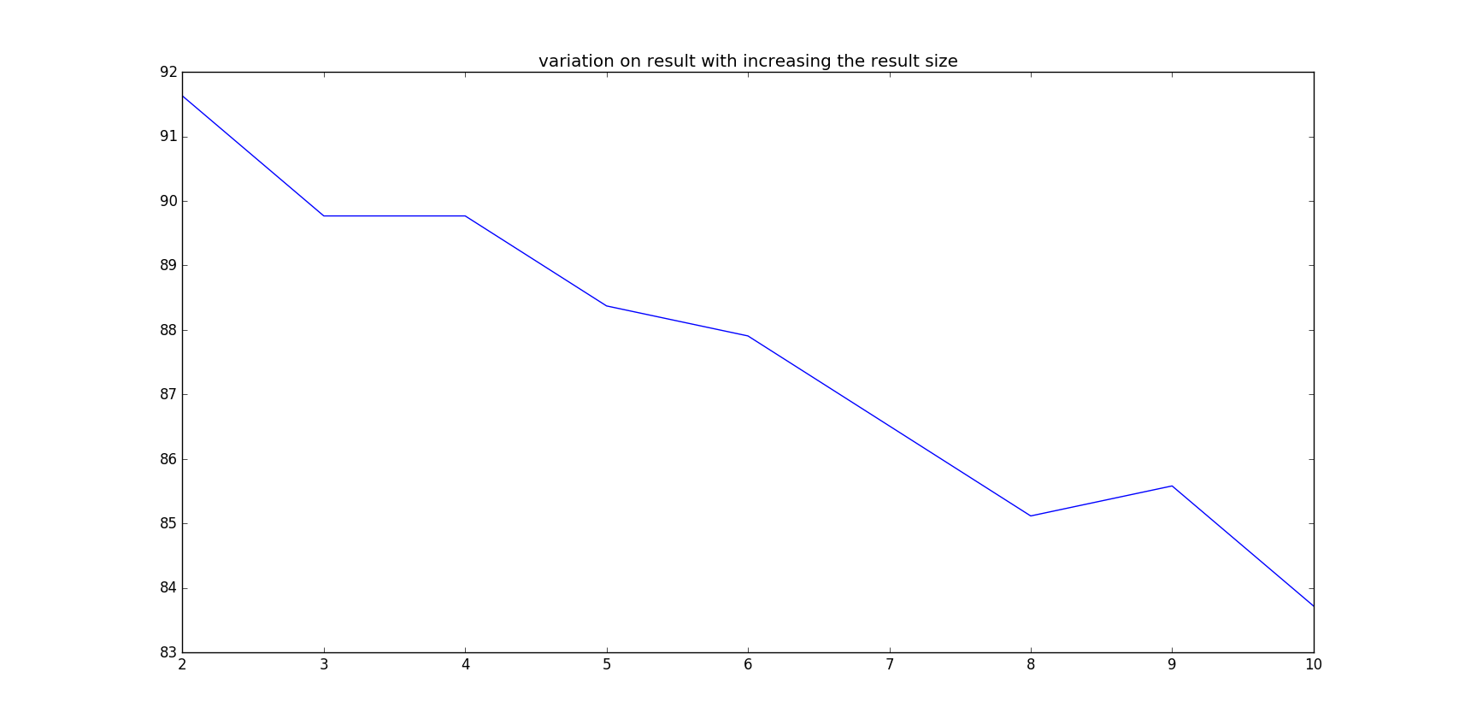
Result
Notes:
‹#›

Slide 32
Thank You
Notes:
‹#›

